Slide 1
Electric water heater

Slide 2
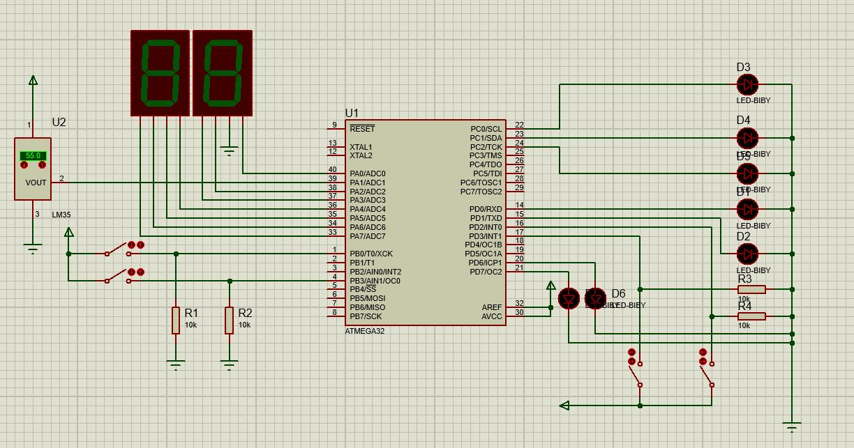
Circuit:

Slide 3
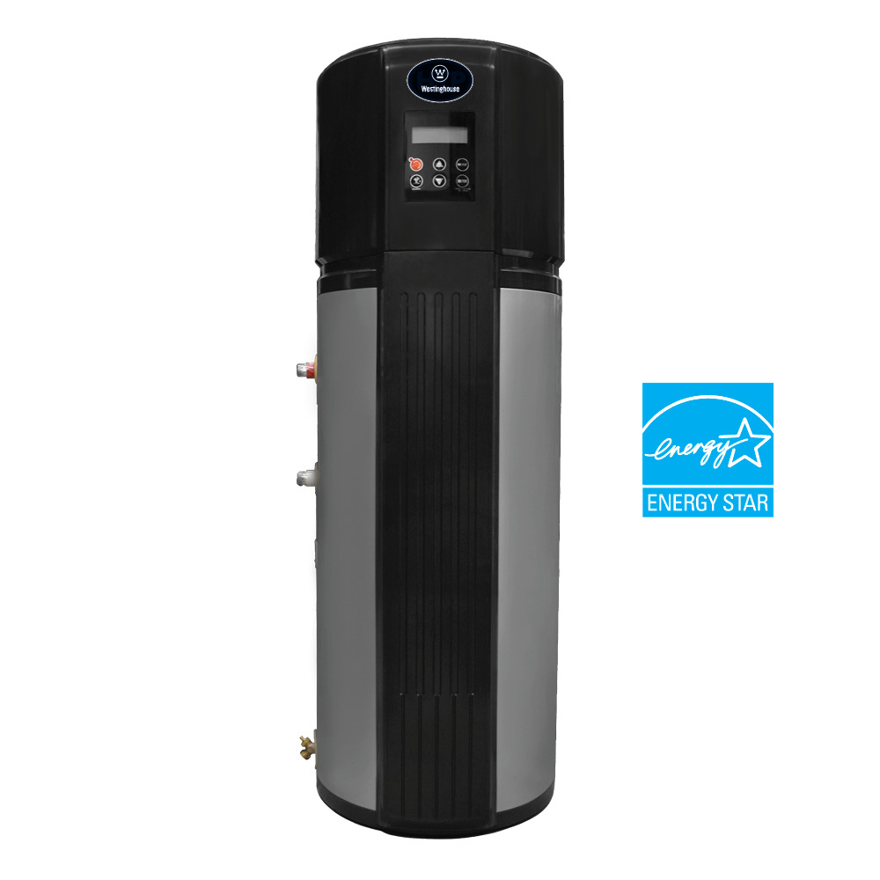
Electric water heater is used in houses in order to obtain water with a desired temperature and the mode of operation either (heating or cooling) is determined according to a feedback from the surrounding using temperature sensor lm35.
This Photo by Unknown Author is licensed under CC BY-NC

Slide 4
Tools:
LEDS: | RESISTORS | SENSORS: | DISPLAY: | SWITCHES:
LED1:USED FOR INDICATING THE SYSTEM MODE EITHER (ON OR OFF) | RES1:USED IN ON SWITCH | TEMP SENSOR: LM35 | 2 BCD 7 SEGMENTS | SW1:ON SWITCH
LED2:COOLING ELE. | RES2:USED IN OFF SWITCH |  |  | SW2:OFF SWITCH
LED3:HEATING ELE. | RES3:USED IN UP SWITCH |  |  | SW3:UP SWITCH
LED4:HEAT OR COOL MODE | RES4:USED IN DOWN SWITCH |  |  | SW4:DOWN SWITCH
LED5:UP TI
LED6:DOWN TI
LED7:TEMP IND

Slide 5
OPERATION’S SEQUENCE:
ON SWITCH IS PRESSED
INTIAL SET TEMPERATURE=60 IS SEEN ON 7 SEGMENTS
TEMPERATURE SENSING TAKES PLACE
COMPARISON BETWEEN TEMPERATURE AND SETTING TEMPERATURE AND ACCORDING TO THIS COMMAND THE PROGRAM DECIDES THE MODE OF OPERATION EITHER HEATING MODE OR COOLING MODE
IF UP OR DOWN SWITCH IS PRESSED AN INTERRUPT TAKES PLACE AND THE PROGRAM ENTERS SETTING MODE AND A TIMER FOR 5 SECONDS IS TRIGGERED IF UP OR DOWN SWITCH IS PRESSED THE TIMER IS RESET AND SETTING TEMPERATURE CHANGES
WHEN SETTING MODE IS ENDED WHEN OVERFLOW OCCURS TO THE TIMER WE RETURN TO THE COMPARISON STEP

Slide 6
Process analysis:
Temp Sensing
Cooling or Heating
Temp Setting Mode

Slide 7
PROJECT’S FOUNDERS:
ENG/Adham ahmed hosney mohammed aboul kheir

